Slide 1
How to use this slide deck
This presentation is for UNICEF staff and other workshop organizers to structure an Out-of-School Children Initiative data and profiles workshop and/or related presentations.
It presents a template for the optional data and profiles training workshop described in the OOSCI Operational Manual Section 2.4, page 40. It would be held after the Launch workshop and before the Barriers workshop.
It can be used for a full training workshop, in part for focused presentations or as a supplement for the technical team’s training on OOSCI methodology.
This deck is intended to support OOSCI teams on workshop preparation, especially with respect to the core components of the OOSCI approach. It does not represent a complete presentation, but a useful start for OOSCI workshop organizers.
It is expected that OOSCI teams will modify and add to this template to suit specific regional and country purposes. For example, placeholder slides can be filled with region and country-specific data, relevant timelines, etc.
A blank OOSCI PowerPoint template with slides for additional sections, icons, figures and other designs can be found at www.allinschool.org

Slide 2
Data & Profiles Workshop
© UNICEF/UN0439619/Dejongh
© UNICEF/UN0439619/Dejongh
OUT-OF-SCHOOL CHILDREN INITIATIVE

Slide 3
Opening Session
TOPICS COVERED
Setting the scene: Opening remarks from [Name], [Organization]
What do we want to achieve in this workshop?
Meet participants
© UNICEF/UNI96265/MINGFANG
1
Data and Profiles Workshop
Opening remarks
Workshop objectives and review of agenda
Introduction of participants

Slide 4
Workshop Objectives
Introduce the technical team and selected steering committee members to the tools and methodology to calculate the 7DE and identify profiles of out-of-school children
Understand the advantages and disadvantages to the main sources of quantitative data available for the profiles of out-of-school children and children at risk of dropping out
Learn about the main OOSCI tools for data analysis: Data inventory template, 7DE Calculation Tool, Stata code
Discuss data discrepancies and data gaps in available data and how to address them
Discuss next steps to finalize the quantitative and profiles analysis
[Note: Modify as appropriate]
Notes:
7DE: Seven Dimensions of Exclusion

Slide 5
OOSCI Data and Profiles Chapter Structure
This workshop covers two chapters of an OOSCI study
Data Chapter (Chapter 1)
Profiles Chapter (Chapter 2)

Slide 6
Agenda
TIME | AGENDA ITEM AND PRESENTER | OPERATIONAL MANUAL SECTION
SESSION 1 | Opening
 | Opening Remarks Meeting Objectives and Review of the agenda Introduction of participants
SESSION 2 | Introduction to the main data sources on the 7 Dimensions of Exclusion (7DE): Administrative data
 | Benefits and limitations of administrative data Visibility model Available data sources and findings of the data inventory tool Overview of key indicators Use of 7DE Calculation tool & visualizations | Section 3.1 Annex B Section 3.1 Section 3.2 Section 3.2
SESSION 3 | Household survey and population census data
 | Benefits and limitations of household survey and population census data Available data sources and findings of the data inventory tool Overview of key indicators (disaggregation; school exposure) Use of Stata code for 7DE; school exposure | Section 3.1 Section 3.1 Section 4.1 Annex G
SESSION 4 | Guidance for analyzing specific profiles
 | OOSC in emergencies Children in child labour Children with disabilities Children from specific ethno-linguistic groups | Annex C Annex D Annex E Annex F
SESSION 5 | Analysis of children, adolescents & youth at risk of dropping out
 | Analysis of known risk factors (ABCs of dropout) Dropout risk Cumulative risk analysis Flow in and out of the schooling system | Section 4.2 Annex H Annex I Section 4.2
SESSION 6 | Next Steps for profiles chapter
 | Plenary discussion: Agree on key data sources, priority indicators and analysis for the profiles chapter Discuss possible data gaps and ways to address them Division of responsibility for completion of profiles chapter | Section 4.4 Section 2.2
Session 1:
Session 2:
Session 3:
Session 4:
Session 5:
Session 6:

Slide 7
Participants
[Share your name, organization and connection to children and adolescents out of school and at risk of dropping out]
[Note: Introduce participants, including members of the OOSCI steering committee and technical team (if already established)]

Slide 8
Administrative Data
TOPICS COVERED
What are the benefits and limitations of administrative data?
What is the visibility model?
What are key indicators?
© UNICEF/UNI177582/RICHTER
2
Data and Profiles Workshop
Benefits and limitations of administrative data (3.1)
Visibility model (Annex B)
Available data sources and the data inventory tool (3.1)
Use of 7DE Calculation tool & visualizations (3.2)

Slide 9
What Are Administrative Data?
In education: Data on students, schools and staff collected by schools through a school census, that is usually annual and feeds into national EMIS systems
Some EMIS systems have unique student identifiers
Other ministries and sectors also collect administrative data (ex. health, civil registry, social protection) which may be useful for studying out-of-school children and children at risk of dropping out
Notes:
EMIS: Education Management Information Systems

Slide 10
Benefits and Limitations of Administrative Data
Benefits:
Time series available for trend analysis
Data are systematically linked from student->school->district->region
Useful for data on children who dropped out or are at risk of doing so
Provide policy-relevant indicators for development plans for targeting and monitoring
Availability of disaggregated data:
Administrative divisions, sex, rural/urban etc. which can also be linked to other sectoral data (e.g., health, water and sanitation, etc.)
Limitations
No direct information on children not in school
Limited information on the characteristics of children who are in school (e.g., no data on household wealth, etc.)
Population based indicators draw on two different data sources (enrolment and population data)
Coverage: private, NGO-run, non-formal and religious schools may not be covered
Challenges in accuracy and consistency:
Lack of systematic school record management
Difficulties in recording ages of pupils
Notes:
NGO: Non-governmental Organizations

Slide 11
Visibility Model
This model helps analysts understand which out-of-school children are ‘visible’ in administrative data (and, therefore, to policy-makers), and which may be missing.
Visible out-of-school children: Can be identified in EMIS (ex. those who dropped out)
Semi-invisible out-of-school children: Not in EMIS but can be identified by cross-referencing other government databases or school records
Dropouts who are still ‘enrolled’: By cross-referencing with school records, EMIS can be updated
School-age children who never attended school: By cross-referencing with civil registry or other local data, these children are identified.
Invisible out-of-school children: Children not recorded in any government database, unless specific and targeted research is undertaken.
What groups of children in your country may be ‘invisible’ in education administrative data?
Notes:
Note: See Annex B for a deeper discussion of the visibility model, and Table 1.2 for a comparison of the visibility model with the 7DE model.

Slide 12
Available Data Sources and the Data Inventory Tool
Available datasets
[Note: List here]
Data Inventory Tool
[Note: Available at www.allinschool.org]
[Note: Describe briefly key characteristics of the available administrative datasets here, using the tool and the summary table, left]
Key data inventory categories for administrative data
Agencies responsible for collection and dissemination of data
Data collection (not publication) date
Frequency of data collection
Definitions: Out-of-school, School entrance age, Enrolment, Attendance, Absenteeism, Drop-out, educational attainment
Population coverage of the collection
Geographic coverage of the collection
Types of disaggregation possible
Data availability and access
Data format
Other information

Slide 13
Findings from the Data Quality Assessment Tool
[Note: Use this slide to present key findings from the application of the Data Quality Assessment Tool (Separate Tab in the Excel tool) to the available administrative dataset(s).]
Use the guiding questions from the Tool, pasted below:
Accuracy of age data?
Coverage of age data?
Coverage of education levels?
Coverage of institution types?
Usefulness for disaggregated analysis?
Usefulness for profiling?
Consistency of education terms?
Comparability of education terms?]
This tool can be used to analyze a single data source, and used to compare sources to identify the most suitable datasets, and identify potential sources of discrepancy

Slide 14
Seven Dimensions of Exclusion (7DE)
The core indicators to calculate for an OOSCI study:
Percentage and number of children in each dimension of exclusion
DE6 and 7 (upper secondary or ISCED level 3) should be calculated regardless of whether it is compulsory in the country, in line with SDG 4.1 (universal secondary education)
Notes:
ISCED: International Standard Classification of Education, produced by the UNESCO Institute for Statistics for cross-national comparable data on education.
SDG: Sustainable Development Goals

Slide 15
Overview of Key Indicators (Administrative Data)
As described in OOSCI Operational Manual (2023) Section 3.2, the key indicators are:
Number of children in each of the 7 Dimensions of Exclusion
The number of students of the official age for the given level of education enrolled in early childhood education, primary, secondary or higher levels of education is subtracted from the total population of the same age.
Rate of children in each of the 7DE
Additional indicators: enrolment, repetition, promotion rates
Disaggregation for administrative data (where applicable): Sex, type of school (private/public, etc.), location (region; urban/rural), grade (ex. dropout), pupil-teacher ratio
Additional disaggregation may be possible in countries with a unique student identifier (ex. absenteeism, learning outcomes, disability)

Slide 16
Use of 7DE Calculation Tool
New 7DE calculation tool: Excel tool to automatically calculate core indicators on the 7DE
Required data:
Basic information about the education system structure (Ex. duration of primary education)
Administrative (EMIS) data on student enrolment, promotion and repetition, by single year of age and sex, for two consecutive years
Population data by sex and single year of age
Additional data:
Household survey data on school exposure (to be discussed in next section)
See Operational Manual Section 3.2
See 7DE Tool user manual for step-by-step instructions

Slide 17
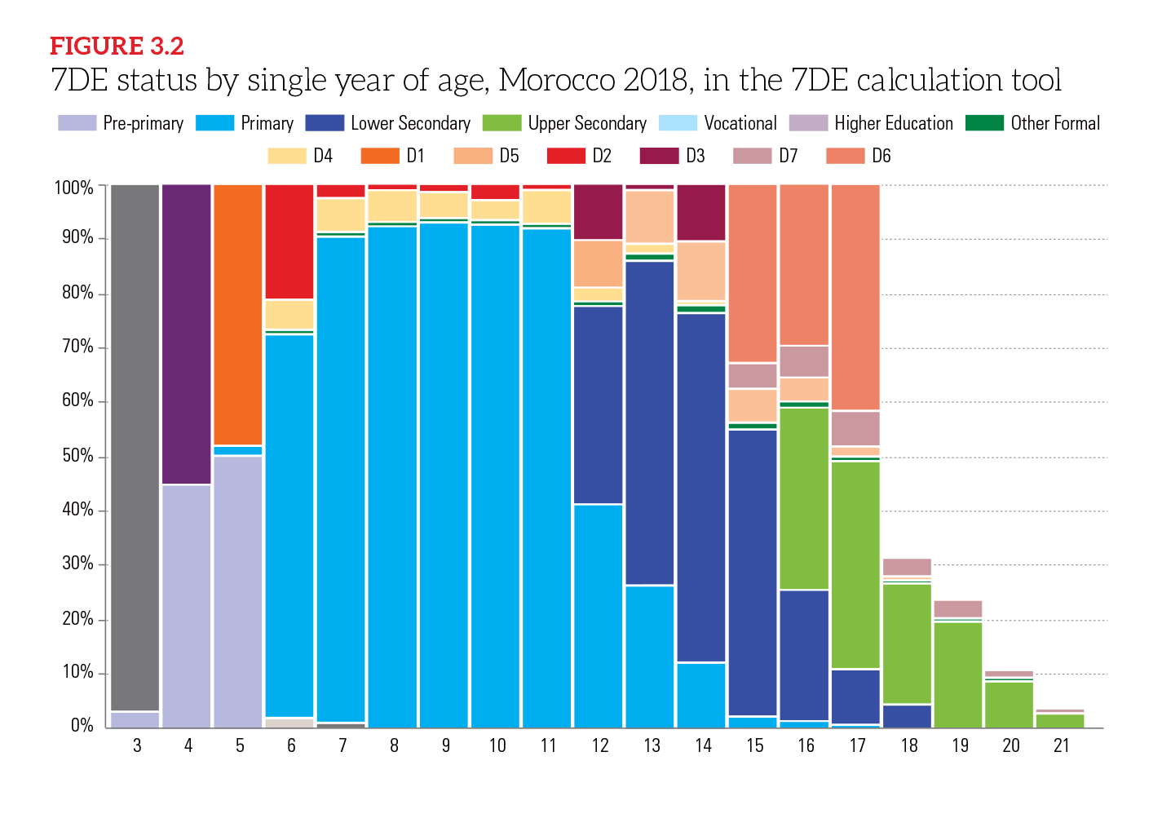
Visualizations from the 7DE Tool
Once the data have been entered into the 7DE tool, it produces a series of visualizations to accompany the statistics and data tables.
Figure 3.2 shows the example of Morocco, with enrollment by single year of age in school (and by level), and out of school (by dimension)
Notes:
7DE: Seven Dimensions of Exclusion

Slide 18
Household Survey and Census Data
TOPICS COVERED
What are the benefits and limitations of household survey and population census data?
What are the available data sources?
What are the findings of the data inventory tool?
What are the key indicators?
Implementation the Stata code for 7DE.
© UNICEF/UNI210680/Babajanyan
3
Data and Profiles Workshop
Benefits and limitations of household survey and population census data (3.1)
Available data sources and findings of the data inventory tool (3.1)
Overview of key indicators and use of Stata code for 7DE (4.1 + Annex G)

Slide 19
What are Household Survey and Census Data?
OOSCI studies use the widest possible range of data to tell a more complete story on children in and out of school.
Household surveys are a very important component of profiles analysis
Household surveys collect data from a representative sample of households on a wide range of topics
May be national or part of international survey programme (ex. Multiple Indicator Cluster Survey (MICS), Demographic and Health Survey (DHS))
Census collect data on an entire population (not sample)
Both are typically administered by the National Statistics Office, not the Ministry of Education

Slide 20
Benefits and Limitations of Household Survey and Census Data
Benefits (Household survey):
Information about children in and out of school in same data source.
Allows multiple disaggregation (sex, location, wealth, family characteristics) on individual and household characteristics
More frequent, less costly than census
May include important demand side education data: reasons for dropout, distance to school, household expenditure on schooling, etc.
Census:
Detailed picture of the entire population
Information about children in and out of school in same data source.
Allows multiple disaggregation (sex, location, wealth, family characteristics) on individual and household characteristics
Limitations (Household survey)
Coverage issues: Groups omitted by design: those not in households: Homeless population, in institutions, hospitals, mobile population. Education levels: private, NGO-run, non-formal and religious schools not always included or clearly identified
Non sampling errors (e.g., interviewer error)
Sampling errors: Groups underrepresented: fragile households, remote areas, slums.
Sampling design not intended to collect data on OOSC.
Not collected on a yearly basis
Errors in age reporting
Census:
Infrequent (every 10 years)
Collects limited education data

Slide 21
Available Data Sources and the Data Inventory Tool
Key data inventory categories for household survey data
Agencies responsible for collection and dissemination of data
Data collection (not publication) date
Frequency of data collection
Definitions: Out-of-school, School entrance age, Attendance, Absenteeism, Drop-out, educational attainment
Sample size
Sample design; Smallest administrative area for which data are statistically accurate
Population coverage of the collection
Geographic coverage of the collection
Types of disaggregation possible
Data availability and access
Data format
Available datasets
[Note: List here]
Data Inventory Tool
[Note: Available at www.allinschool.org]
[Note: Describe briefly key characteristics of the available household survey and population datasets here, using the tool and the summary table, left]

Slide 22
Findings from the Data Quality Assessment Tool
[Note: Use this slide to present key findings from the application of the Data Quality Assessment Tool (Separate Tab in the Excel tool) to the available household survey datasets.]
Use the guiding questions from the Tool, pasted below:
Accuracy of age data?
Coverage of age data?
Coverage of education levels?
Coverage of institution types?
Usefulness for disaggregated analysis?
Usefulness for profiling?
Consistency of education terms?
Comparability of education terms?
Data coverage of population of interest?
Consistency of age and school participation data?
This tool can be used to analyze a single data source, used to compare sources to identify the most suitable datasets, and identify potential sources of discrepancy.

Slide 23
Overview of Key Indicators
Household survey data should also be used to calculate the number and rate of children in each of the 7 Dimensions of Exclusion.
Given the differences between administrative and household survey data collection and design, discrepancies in the out-of-school children and dropout risk estimates they produce is very common!
Additional indicators: Educational attainment, foundational literacy rate (MICS), school exposure (see next slide)
Disaggregation for household survey data (where applicable or available): Age, sex, type of school, location (region; urban/rural), grade (ex. dropout), household wealth, child labour, parental education, ethnicity or language of household head, family status (orphanhood, number of siblings), foundational literacy (MICS), disability (MICS)

Slide 24
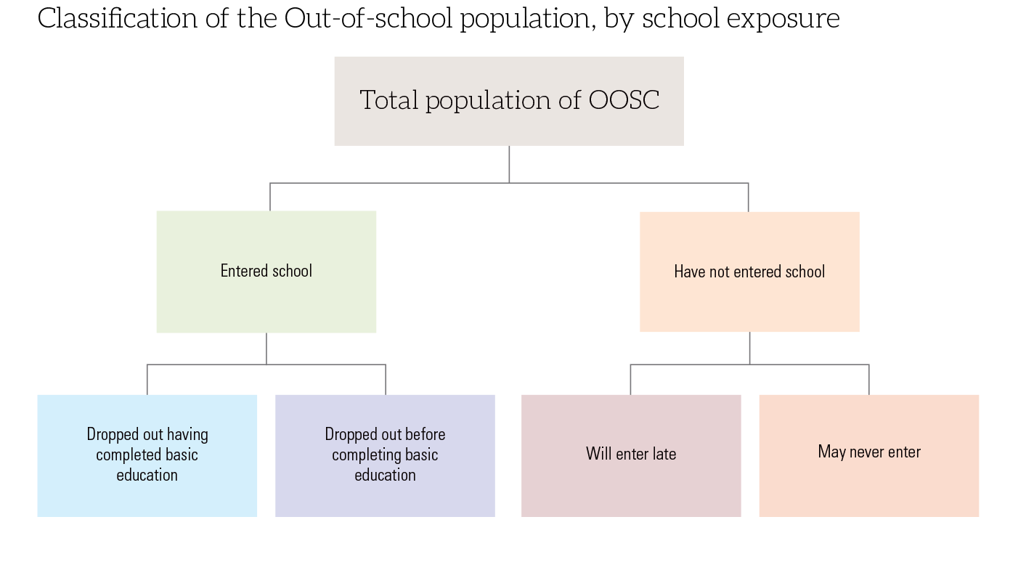
School Exposure of Out-of-School Children and Adolescents
Out-of-school children and adolescents have a range of school experiences
They may have:
Dropped out before or after having completed basic (lower secondary) education
Never entered, but will in the future as overage
Never entered, and may never enter
Household survey data is needed to identify children who not entered school

Slide 25
Tools: Stata Code, 7DE Tool, Annexes
Calculating the classification of out-of-school children by school exposure
Step 1: With household survey data, use/adapt the Stata code provided in Operational Manual Annex G to calculate the base indicators
Step 2: Input these data into the 7DE Tool, tab “D236 Classification”
Specific guidance on key profiles of out-of-school children discussed in Session 5, and in Operational Manual Annexes C to F.

Slide 26
Guidance for Analyzing Specific Profiles
TOPICS COVERED
Who are out of school children in emergencies and what extra considerations for data collection and analysis does this profile pose?
What constitutes child labor, and what additional questions might be considered in analysis?
Whoa re children with disabilities, and what specific challenges does this profile face?
© UNICEF/UNI93409\Sibonelo Khumalo
4
Data and Profiles Workshop
OOSC in emergencies (Annex C)
Children in child labour (Annex D)
Children with disabilities (Annex E)
Children from specific ethno-linguistic groups (Annex F)

Slide 27
Children in Emergencies
These children may be forcibly displaced refugees, internally displaced persons or asylum seekers or otherwise crisis affected
Many not included in out-of-school children estimates
Data challenges: Urgent need for accurate, timely data to target education response. Yet emergencies and mass population movement disrupt routine collection of enrolment and population data
Considerations for data and profiles analysis:
Use flexible and mixed methods (quantitative and qualitative) to get best information on profiles; triangulation may be necessary across multiple data sources
Consider what kinds of education programming counts as “in school”
Four case studies of managing the complexities of data in emergencies:
Global estimates; Syria; Haiti; South Sudan
Full details presented in Annex C

Slide 28
Children in Child Labour
According to 18th ICLS Resolution, child labour in an OOSCI analysis is:
5 to 11-year-olds in economic activity
12 to 14-year-olds in non-light (or ‘regular’) economic activity
5 to 14-year-olds in hazardous unpaid household services
15 to 17-year-olds working in economic activity for 43 or more hours per week.
Additional profiles of interest:
Young people aged 15-17 who are in employment, but not in child labour (i.e. engaged in hazardous forms of work)
Young people who are neither in employment, education or training (NEET) (SDG 8.6.1)
Annex D (ILO) provides a detailed guidance to develop a statistical profile of children in child labour and school participation.
Questions for analysis:
What proportion of children is involved in child labour? To what degree do the child labour and out-of-school children populations overlap?
What work activities do out-of-school children perform?
Does child labour interfere with education?
What are the household characteristics of children in child labour and out-of-school children?
Notes:
ICLS: 18th International Conference of Labour Statisticians in 2008

Slide 29
Children with Disabilities
Reporting on disability:
Children with disabilities may be ‘invisible out-of-school children’ due to stigma.
Others may be ‘semi-invisible’ out-of-school children because they live in residential care institutions (not captured in household surveys or in EMIS as they do not attend Ministry of Education schools)
Data on disability can be found in a variety of sources – each has specific considerations on definitions used, coverage and possibilities for disaggregated analysis.
National population census; Household surveys; National disability surveys; Administrative data
Important to disaggregate all 7DE indicators by disability, and if possible:
By type of impairment/functional disabilities; by type of school or classroom (segregated vs. mainstream)
Full details presented in Annex E

Slide 30
Children from Specific Ethno-Linguistic Groups
Encompass a wide range of groups within a country who may have distinct linguistic, ethnic, cultural and/ or religious characteristics.
[Note: Add here relevant examples of such groups of children which could be relevant for the analysis]
Considerations for data and profiles analysis:
May be invisible in data collection (data not collected)
Existing data collected in different ways (self-report; language of household head) that require deeper assessment
Disaggregation may be difficult if the group is small or disbursed, in sample surveys
Other characteristics linked to education exclusion (e.g., sex, poverty) may compound educational disadvantage for these children.
Full details presented in Annex F

Slide 31
[Placeholder slide for additional priority profiles to include in analysis]
[Note: This slide can be used for country or region-specific priority groups of children the OOSCI team would like to include in the data and profiles chapter. This could include specific considerations for data availability, indicator calculation, and disaggregated analysis. For example:
Children in pastoral communities
Orphans
Homeless children
Children enrolled in remote learning]

Slide 32
Analysis of Risk of Dropping Out
TOPICS COVERED
What are the levels of risk associated with a student dropping out?
What factors are considered when assessing risk level, and what are the ABC’s of dropout?
How can you analyze data to identify exclusion points?
© UNICEF/UN0618450/BARUAH
5
Data and Profiles Workshop
Analysis of known risk factors (ABCs of dropout) (4.2)
Dropout risk (Annex H)
Cumulative risk analysis (Annex I)
Flow in and out of the schooling system (4.2)

Slide 33
Children, Adolescents and Youth at Risk of Dropping Out
All students face some risk of dropping out of school before completion
OOSCI identifies varying levels of dropout risk based on age for grade and learning proficiency:
Low risk: Students at the official age for the grade and meeting minimum proficiency levels
Medium risk: Students up to 2 years overage and/or below minimum proficiency levels
High risk: Students up to 2 years overage and below minimum proficiency levels
[Note: This classification could be modified based on country context]
Notes:
Dropout risk
RODO: Children at Risk of Dropping Out
MPL: Minimum proficiency level (of learning)

Slide 34
Two Ways to Analyze Risk of Dropout (DE 4, 5 and 7)
ABCs of school dropout
Summary of Box 4.2 (Operational Manual)
Method 1: Analysis of known risk factors
Identify risk factors linked to dropout (ex. overage enrolment, poor academic achievement) and calculate the percentage of currently enrolled students with that risk factor
Stata code in Annex H to calculate share of children 2+ years overage for grade (see next slide)
Threshold can be adapted based on country context
Three risk factors of disengagement from school: easily observable measures at school level for individual students:
Academic achievement
Behaviour problems
Chronic absenteeism
More information on definitions, measurement and calculation of dropout risk in Annex B and Monitoring Education Participation.

Slide 35
Two Ways to Analyze Risk of Dropout (DE 4, 5 and 7)
Method 2: Calculation of dropout risk using two years of school attendance data
Reconstructed cohort method
Using household survey data, Stata code in Annex H data to calculate share of primary students who dropped out:
Before primary completion
After primary completion (did not transition)
Annex H code will produce data for a table similar to Table 4.2

Slide 36
Flow in and out of the Schooling System
To develop profiles, important not just ‘who’ and ‘where’ out-of-school children are, but at what point in their education pathway they became out of school.
Analysts can thus identify points in time, or critical milestones, where children are often ‘lost’ from the education system.
Common points in time that may create or worsen educational exclusion:
(Non-) or late entry into school;
Repetition, which may be more common in Grade 1 or in grades coinciding with national examinations;
Promotion between grades; and
Transition between levels of education, particularly from basic to upper secondary, which often faces greater supply constraints and has higher expectations of learning.
Two ways to identify these exclusion points: current trend analysis and pathway analysis (next slides).

Slide 37
Current Trend Analysis to Identify Exclusion Points in the Education System
Analyze indicators such as dropout rate and repetition rate by grade, transition rates between levels
7DE Tool calculates these indicators
Example: in Figure 4.3, the transition between lower and upper secondary education is an exclusion point
Can also generate an education pyramid figure (See Figure 4.4 in the Operational Manual)

Slide 38
Education Pathway Analysis
Uses most recent household survey for a country to visualize the historical progression of youth of upper secondary age (retrospective cohort analysis)
Shows the percentage of upper secondary age youth who:
Ever entered primary
Dropped out before primary completion or after completion
Dropped out before lower secondary completion or after completion
Etc.
Compare the education pathway of different groups: ex. male/female; richest/poorest
The online dashboard for country analysis: https://data.unicef.org/resources/how-are-children-progressing-through-school/

Slide 39
Cumulative Risk Analysis & Regression
Cumulative risk analysis uses household survey data to look at the ‘added’ impact of multiple disadvantageous background characteristics
By decomposing these characteristics, analysts can identify more precisely the profiles of children at highest risk of being out of school
In the example, girls are not necessarily more likely to be out of school, in more well off, urban households. But their likelihood to be out of school is over 5 times higher if they are in rural, poor households with a mother that did not attend primary.
Uses Stata code in Annex I of the Operational Manual to calculate cumulative risk analysis
Additional regression analysis can be used to identify the significant predictors of school enrolment.

Slide 40
Next Steps for Profiles Chapter
TOPICS COVERED
What are the key data sources for [REGION/COUNTRY]?
What indicators have the highest priority in assessment of risk?
What tasks need to be completed and by whom to complete the profiles chapter?
© UNICEF/UN0362385/Pancic
5
Data and Profiles Workshop
Plenary discussion: Agree on key data sources, priority indicators and analysis for the profiles chapter (4.4)
Discuss possible data gaps and ways to address them
Division of responsibility for completion of profiles chapter (2.2)

Slide 41
Discussion: Main Data Sources, Indicators and Analysis for Data and Profiles Chapters
After having reviewed the relevant data sources, common profiles of children in the 7DE, and analysis strategies, the team and steering committee can agree on initial priorities and direction for the OOSCI data and profiles chapters.
These priorities may change based on the results of the data and profiles analysis, but provide useful guidance to the Technical team.
Plenary discussion:
What are the main household survey data sources the OOSCI study should consider?
What are the main administrative data sources (in addition to the EMIS) the OOSCI study could consider, to identify semi-invisible out-of-school children?
What are the key indicators it should examine (in addition to the 7DE)? Should some dimensions of exclusion be focussed on for deeper analysis?
Are there specific profiles of out-of-school children or children at risk of dropping out that should be highlighted in the analysis?
[Note: Add/Modify questions as suitable to the country/workshop design]

Slide 42
Discussion: Possible Data Gaps
Identify possible missing or unavailable quantitative data on groups of children, areas of the country, important background information
Plenary discussion: Based on your knowledge of the data available in EMIS, household surveys, and other sources (census, civil registry, etc.):
Which are the main data gaps analysts could anticipate?
Who are the main groups of ‘invisible’ out-of-school children (Not captured in any government database)?
Who are the ‘semi-invisible’ out of school children and children at risk of dropping out (Not captured in EMIS)? (ex. children who never enrolled in school)
Are there certain types of education not covered in EMIS?
How should the OOSCI study address these gaps? Are there any stakeholders, additional sources of information (qualitative) or otherwise which could provide more information for profiles analysis?
[Note: Add/Modify questions as suitable to the country context]

Slide 43
Next Steps for Completion of Data and Profiles Chapters
Technical team members involved in data and profiles chapters: [Note: List, with leads on data acquisition, analysis, writing]
Timeline for chapter drafting: [Note: Add key deadlines here]
Role for Steering Committee members: [Note: Add key roles here – may include data request support, feedback on early analysis]
Proposed date for the Barriers workshop: [Note: add dates here]

Slide 44
Thank You
CONTACT
First Last Name
Role or Title Here
Name of Department
email@address.org
© UNICEF/UN0518460/Bidel
ALLINSCHOOL.ORG
Question and Answer Session

